Slide 1
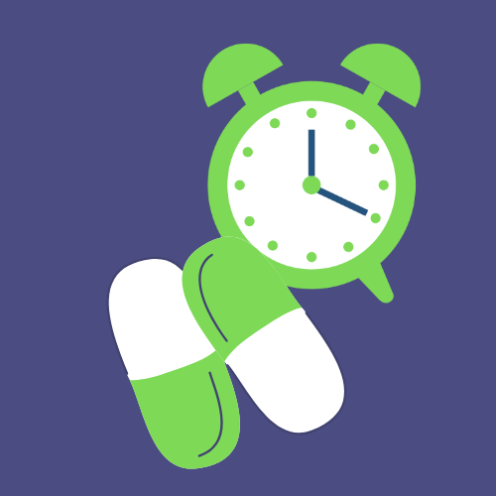
PillEasy
Team Name SlowCodeTransform
By:
Harshit Gupta (MT21028)
Madiha Tariq (MT21125)
Mohnish Basarkar (MT21052)
Niharika (MT21132)
Shrey Rastogi (MT21145)

Slide 2
MOTIVATION
The motivation to build this product came from observing the elderly people in the family having to suffer through the stress of missing out on pills in the absence of regular supervision. Many times hospitals also display a lack of supervision. People sometimes take incorrect medicines due to lack of information or misjudgment. Neither do they have a proper listing of the medication they are taking and when to consume them. All these happenings motivated us to develop an easy solution for the aged and the ailing.
1

Slide 3
PROBLEM STATEMENT
There are times when people miss their medicines due to busy schedules, or maybe they fail to remember those. We are developing an app that keeps track of the time when a person needs to have medicine and alerts him/her regarding the same, along with other add-on features like they can track the blood pressure(systolic/diastolic), sugar and weight, and can share the report via email. Users can also click photos of the medicine strips and prescription images and save them in local storage.
2

Slide 4
RELATED WORK
There are times when people miss their medicines due to busy schedules, or maybe they fail to remember those. We are developing an app that keeps track of the time when a person needs to have medicine and alerts him/her regarding the same, along with other add-on features like they can track the blood pressure(systolic/diastolic), sugar and weight, and can share the report via email. Users can also click photos of the medicine strips and prescription images and save them in local storage.
3

Slide 5
IMPLEMENTED FEATURES
4

Slide 6
Welcome walkthrough Screen
Register and Login
Users can add or delete medicines
Rescheduling of medicine (Edit Medicines)
Category of medicine(pill/spray/injection/cream etc.) can be added along with medicine.
Multiple reminders, i.e., if the medication is taken twice or thrice a day
The Medicine doses, along with starting and ending dates, can be set.
Add corresponding medicine strip image

Slide 7
Medicine names extracted from the medicine strip images (using Computer Vision)
Keeps track of weight, blood pressure, and sugar and stores them in SQLite database.
The custom report of regular Health updates can be sent over mail.
Also, the graph for the health details is plotted to show day-to-day fluctuation in values.
Add and save images of Prescriptions.
There is a pop-up notification at the user's set time of taking medicine.

Slide 8
TOOLS AND TECHNOLOGIES
5
Android Studio
SQLite Database
Android Programming using Java
Google Material Design
Any Chart Library
Optical Character Recognition

Slide 9
FUTURE WORK
6

Slide 10
One future work can be to add doctors who can interact with patients and keep track of them.
Another exciting field can be to add an e-commerce website where patients can shop for medicine.
Lab pathology can also be added where users can take the medical test described by doctors at one door.
We can also use printed prescriptions to fill all medicines the patient has to take at what time and interval in the future.

Slide 11
CHALLENGES
Several libraries are supported by only a few particular android versions, like the camera feature, which works for Android versions lower than 10.
PDF generation for daily health details was not possible due to issues with storage and saving issues with Android versions.
7

Slide 12
CONTRIBUTIONS
Madiha Tariq (MT21125): SignUp and Login implementation,
Health graph implementation
Harshit Gupta (MT21028) : Landing page (where all medicine with its corresponding dose ,time and date), OCR implementation for medicine name extraction.
Niharika (MT21132): Walkthrough Screen, Health Details and Sharing, Prescriptions Module Implementation.
Shrey Rastogi (MT21145):- Medicine name and medicine intake type selection view and notification reminder system.
Mohnish Basarkar (MT21052) : Added reminders and schedule sections along with taking picture of medicine strips. Added edit and delete functionality.

Slide 13
THANK YOU !

